Slide 1

Vivekanand Education Society’s Institute Of Technology
Department Of Information Technology
DSA mini Project
A.Y. 2025-26
Sustainability Goal : Smart mobility & efficient resource utilization
Title: Parking Allocation System
Domain: Data Structures and Algorithms for Parking Optimization
Member: Deepak Nishad - 42
Mentor Name: Mrs. Kajal Jewani

Slide 2


Slide 3
Content
Introduction to the Project
Problem Statement
Objectives of the Project
Scope of the Project
Requirements of the System (Hardware, Software)
ER Diagram of the Proposed System
Data Structure & Concepts Used
Algorithm Explanation
Time and Space Complexity
Front End
Implementation
Gantt Chart
13. Test Cases
14.Challenges and Solutions
15. Future Scope
16. Code
17. Output Screenshots
18. Conclusion
19. References (in IEEE Format)

Slide 4
Introduction to Project
The Smart AI-Powered Parking Allocation System automates and optimizes parking management using advanced Data Structures and Algorithms (DSA). It uses:
AVL Tree for storing and managing parking slots efficiently.
Queue for handling waiting cars when all slots are full.
Two Stacks for Undo/Redo functionality.
AI Assistant (OpenAI API) for smart suggestions and responses.
IPinfo API for automatic location detection. This project demonstrates how DSA concepts and AI technologies can be combined to build real-world smart automation solutions.
r Rates

Slide 5
Problem Statement
Managing parking slots manually leads to confusion, delays, and inefficient usage of available space.
Users waste time searching for empty slots.
Most small parking systems do not integrate data structures or AI to improve allocation efficiency.
There is a need for a real-time, efficient, and intelligent parking slot management system that is easy to use and educationally valuable.
r Rates

Slide 6
Objectives of the project
r Rates
To build an automated parking allocation system using AVL Tree for balanced and fast operations.
To handle overflow using a Queue of waiting vehicles.
To provide Undo/Redo operations using two stacks.
To integrate OpenAI’s API for AI-powered assistance and smart suggestions.
To visualize the parking map using an ASCII grid layout.
To maintain a session history log with runtime data for analysis.

Slide 7
Requirements of the system (Hardware, software)
Hardware Requirements
Processor: Intel i3 or above
RAM: 4 GB minimum
Storage: 100 MB free space
Software Requirements
Operating System: Windows / macOS / Linux
Language: Python 3.10+
Libraries: requests, openai, uuid, collections
Environment Variables:
OPENAI_API_KEY – for AI assistant
IPINFO_TOKEN – optional, for location services
lem Statement
Prob Statement

Slide 8
ER diagram of the proposed system

Slide 9
Data Structures & Concepts Used
Data Structure | Purpose | Complexity
AVL Tree | Store parking slots (balanced BST) | O(log n)
Queue (deque) | Manage waiting cars | O(1)
Stack | Undo/Redo functionality | O(1)
UUID | Unique session/user ID | O(1)
ASCII Grid | Visual representation | O(n)

Slide 10
Front End
Built an interactive web interface using HTML, CSS, and JavaScript.
Displays parking slots visually — Free / Occupied.
Allows users to park, remove, undo, and redo with buttons.
Uses AJAX / Fetch API to communicate with Python backend.
Includes an AI Assistant chat box for smart suggestions.
Designed to be responsive and user-friendly across devices.

Slide 11
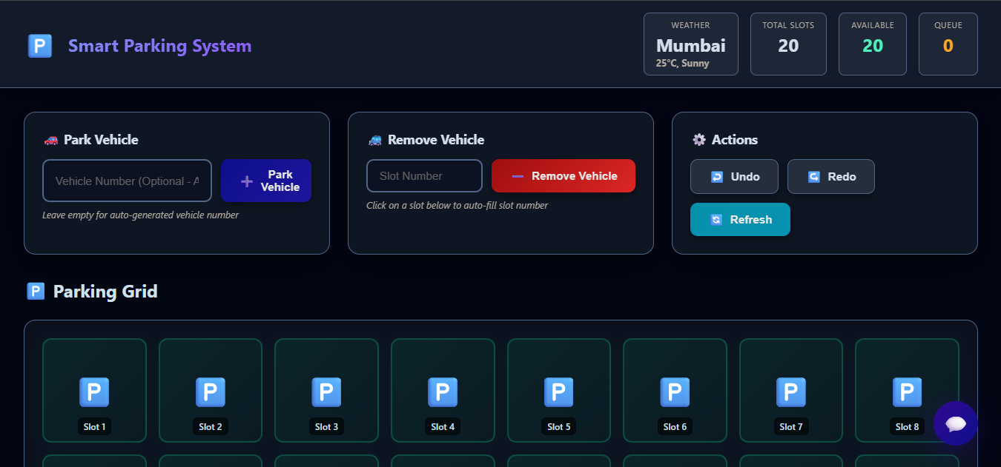
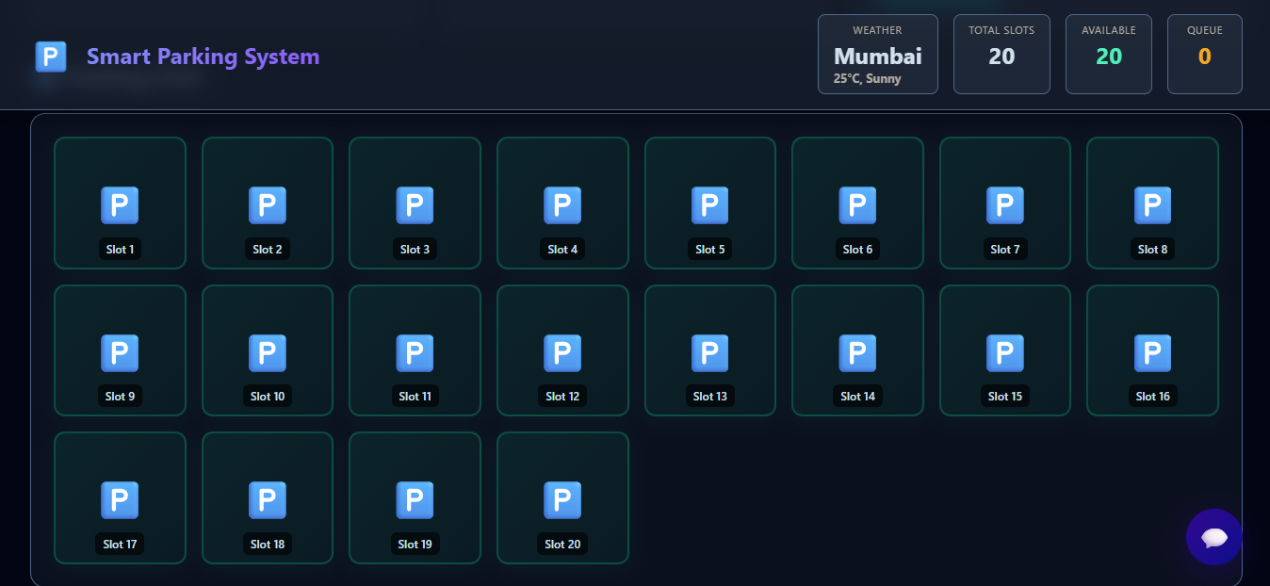
Front End

Slide 12
Implementation
Frontend (HTML, CSS, JS): Handles user input, displays grid, and interacts with backend.
Backend (Python): Manages AVL tree, queue, and stack logic.
APIs: HuggingfaceAI for AI help, IPinfo for location lookup.
Flow:
User action on web UI → Request to backend → DSA logic executes →Response sent back and shown on screen.
Tools: Python, Flask (or FastAPI), HTML, CSS, JS, HuggingfaceAI API

Slide 13
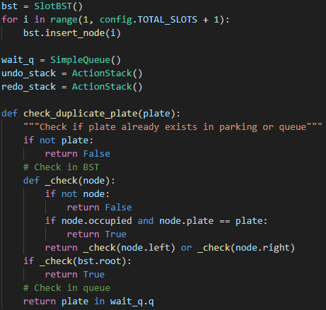
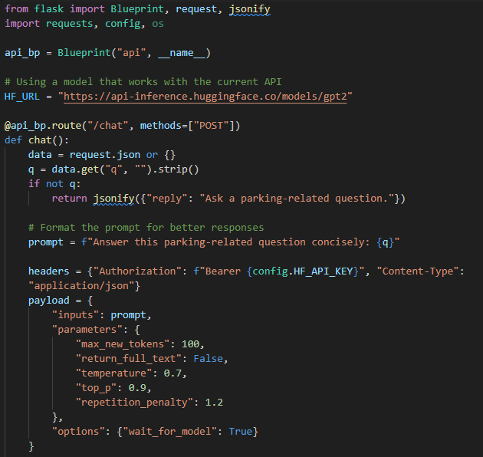
Implementation

Slide 14
Gantt Chart
Phase | Duration | Tasks
Research & Design | Week 1 | Study DSA, plan architecture
Implementation | Week 2–3 | Code AVL, Queue, Stack
Integration | Week 4 | Add OpenAI & IPinfo
Testing & Debugging | Week 5 | Test all functions
Documentation | Week 6 | Prepare report & presentation
Notes:
The max flow algorithm in the visualization is :-

Slide 15
Conclusion
Successfully developed an AI-assisted smart parking system using BST Tree, Queue, and Stacks.
System achieves efficient slot allocation and easy reversibility of actions.
Combines core DSA with practical APIs for real-world applications.
Demonstrates how data structures can enhance automation and efficiency

Slide 16
References
GeeksforGeeks – AVL Trees and Data Structures
Python Documentation – collections.deque, uuid, datetime
OpenAI API Documentation – openai.ChatCompletion
IPinfo API Documentation – Location Lookup API
GitHub examples on Undo/Redo data structure patterns

